Slide 1
A Multivocal Literature Review of Current Tools for Increasing the Degree of Automation in the Development of Secure and Privacy Compliant Applications
John Nguyen, 23. November 2020, Final Presentation

Slide 2
Outline
  Motivation and background
  Research goal and methodology
    Methodology
    Research questions
    Search strategy
  Results
    Key drivers for security automation tools
    Tool classification
    Mapping of tools with security activities
  Summary
    Conclusion
    Limitations
  Bibliography

Slide 3
Motivation and background (cont’d)
Average cost of a data breach by security automation level in organizations worldwide from 2018 to 2020 (in million U.S. dollars)
Note: Worldwide; August 2019 to April 2020; 524 organizations
Further information regarding this statistic can be found on page 8.
Source(s): IBM; Ponemon Institute; ID 1176688

Slide 4
Motivation and background (cont’d)
Need for security and privacy automation tools
Challenges in agile software development
  Neglection of non-functional requirements
  Rapid pace of development and deployment
  Knowledge boundaries (e.g., documentation) [3-4]
Benefits
  Improving scalability
  Reducing human error [1]
  Checking continuously instead of an interval basis [2]
  Avoid cost explosion due to fixing at implementation stage [9]
  Lack of security experts [10]
  Parallel testing [13]
→ Challenges of finding relevant security automation tools
  Lack of an overview of current security automation tools
  State-of-the-practice overview lack level of abstraction [5-6]

Slide 5
Outline
  Motivation and background
  Research goal and methodology
    Methodology
    Research questions
    Search strategy
  Results
    Key drivers for security automation tools
    Tool classification
    Mapping of tools with security activities
  Summary
    Conclusion
    Limitations
  Bibliography

Slide 6
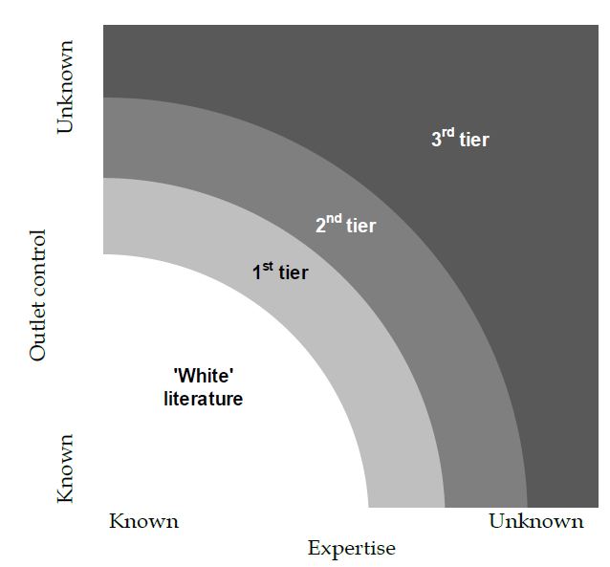
Methodology
Multivocal literature review
  Form of systematic literature review
  Covers both the state-of-the-art and practice
  Inclusion of a large body of grey literature
Benefits
  Certain evidence is often based on experience and opinion
  Inclusion of real-world needs in industrial settings
  May avoid publication bias
Challenges
  Quality assessment
  Large volumes of data → need for a termination criteria
  Bias and lack of quality [14]
Shades of grey literature by Adams, R. J., Smart, P., & Huff, A. S. (2017). Shades of grey: guidelines for working with the grey literature in systematic reviews for management and organizational studies. International Journal of Management Reviews, 19(4), 432–454. Figure 1. Shades of grey literatures

Slide 7
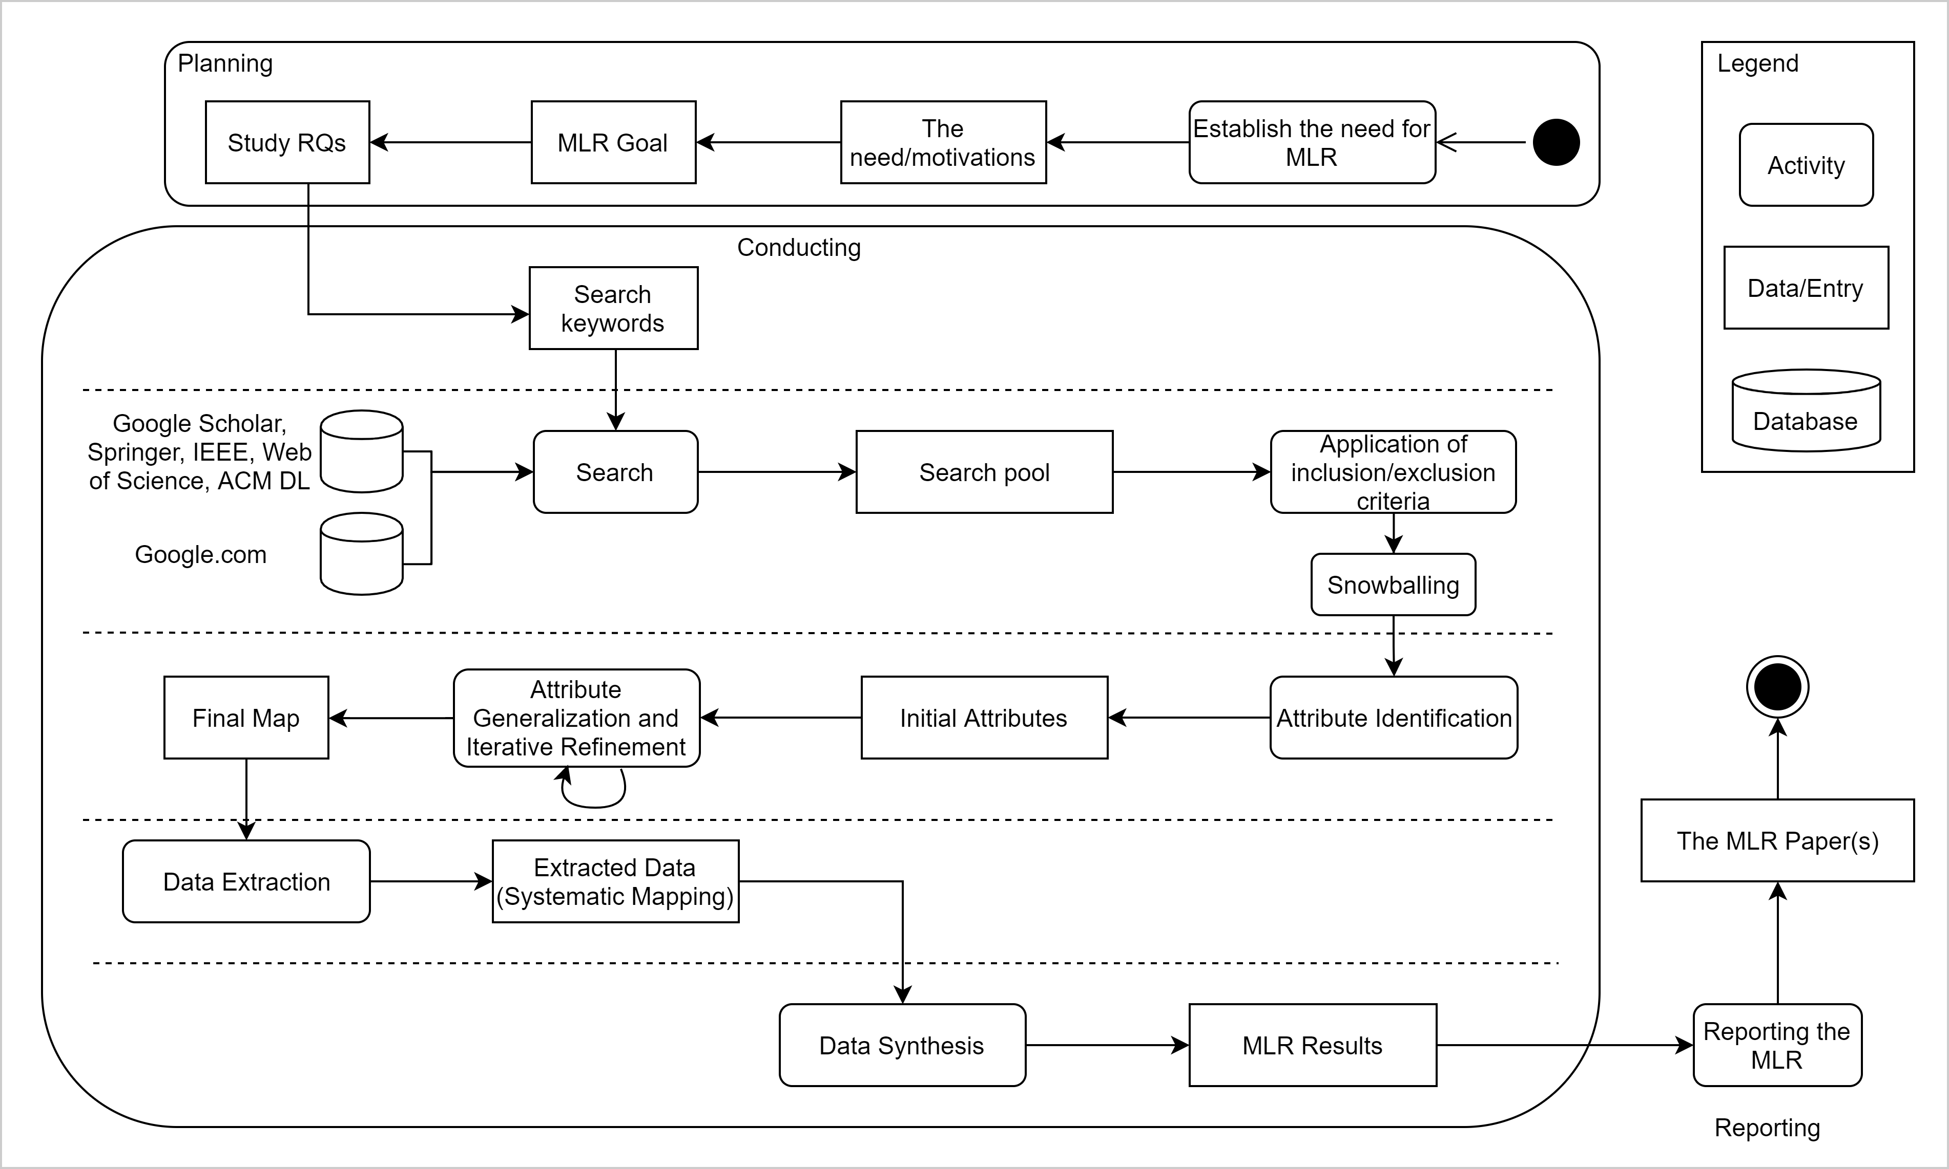
Methodology (cont’d)
Based on Multivocal literature review process by V. Garousi, M. Felderer, and M. V Mäntylä, “Guidelines for including grey
literature and conducting multivocal literature reviews in software engineering,” Inf. Softw. Technol., vol. 106, pp. 101–121, 2017

Slide 8
Research questions
Research questions
  Research questions 1 (RQ1): What challenges can automation tools address when developing security and privacy compliant applications?
  Research questions 2 (RQ2): How can the identified tools and technologies be classified?
  Research questions 3 (RQ3): How can the identified tools be mapped to the activities of the BSIMM10 framework to assess the current automation level?

Slide 9
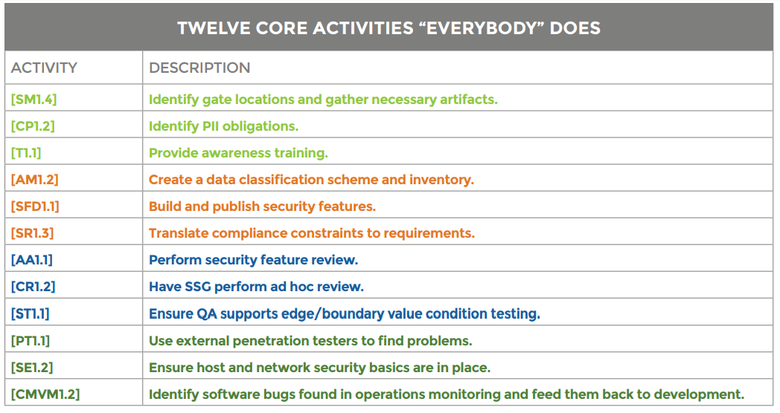
BSIMM10
Building Security In Maturity Model (BSIMM)
Four domains with 12 practices including 119 activities
Domains
  Governance
    Strategy & Metrics (SM)
    Compliance & Policy (CP)
    Training (T)
  Intelligence
    Attack Models (AM)
    Security Features & Design (SFD)
    Standards & Requirements (SR)
  SSDL Touchpoints
    Architecture Analysis (AA)
    Code Review (CR)
    Security Testing (ST)
  Deployment
    Penetration Testing (PT)
    Software Environment (SE)
    Configuration Management & Vulnerability Management (CMVM) [15]
https://www.hack2secure.com/images/blog/BSIMM%20Skeleton%2002.png (13.06.2020)

Slide 10
Search strategy
Academic literature
Grey literature
Inclusion criteria
Written in English and full test accessible
Accessible with TUM rights or freely accessible
Online available
The paper must discuss security or privacy compliance automation
The paper must include any kind of tool, framework demonstration/implementation, prototype, or similar to the support software development lifecycle
Within the Software Engineering domain
The paper must be published in a journal or conference paper
Published between 2015-2020 (initial search)
Exclusion criteria
Duplicates or repeated studies
Lack of relevance for RQs
Algorithms and concepts
Workshops and tutorials are excluded
Inclusion criteria
Written in English and full test accessible
Accessible with TUM rights or freely accessible
Online available
The artifact must discuss security or privacy compliance automation
The artifact must include any kind of tool, framework demonstration/implementation, prototype, or similar to the support software development lifecycle
Within the Software Engineering domain
Published between 2015-2020 (initial search)
Exclusion criteria
Duplicates or repeated studies
Lack of relevance for RQs
Algorithms and concepts
Thesis, Workshops, and tutorials are excluded

Slide 11
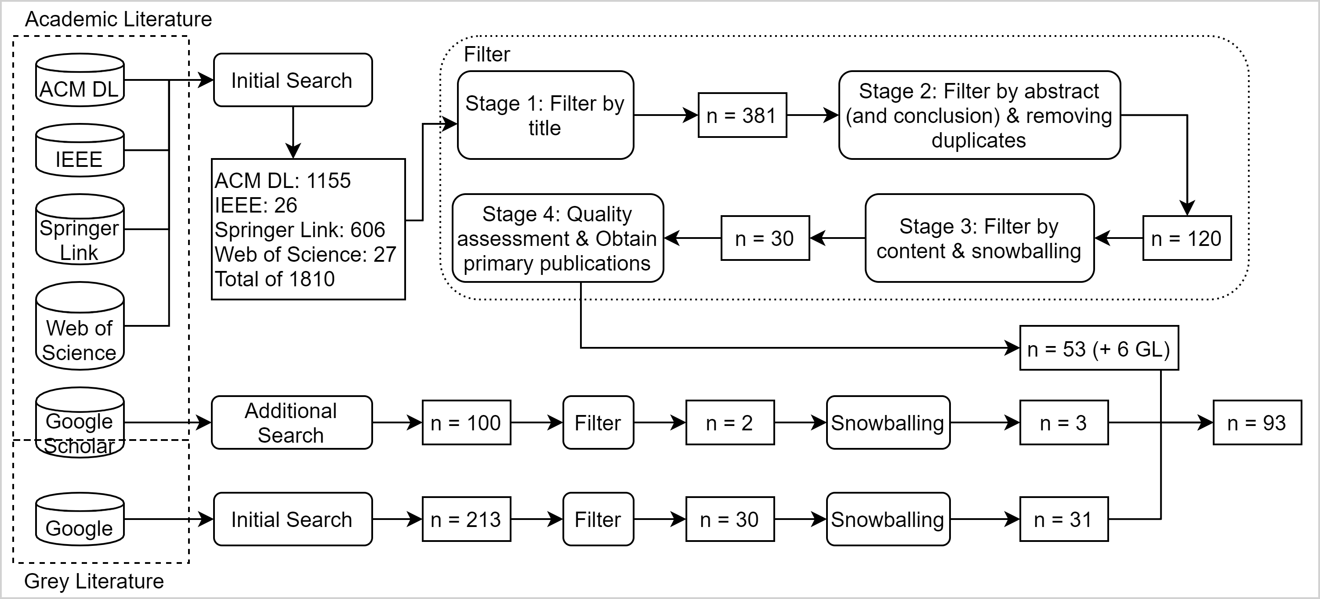
Search strategy (cont’d)

Slide 12
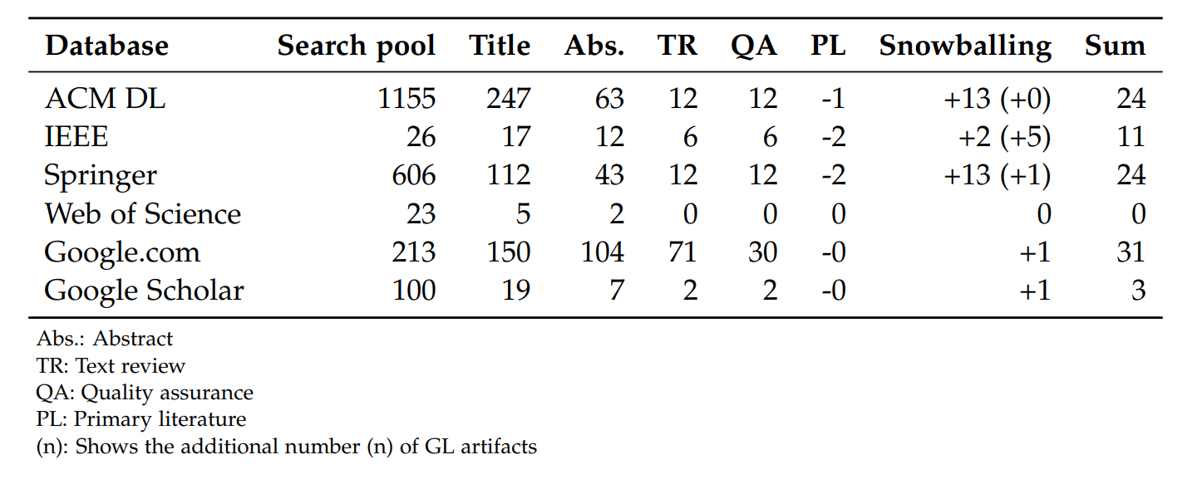
Search strategy (cont’d)
Search string
  SLR: (secur* OR priva* OR protect*) AND ("software development" OR "software engineering") AND (tool* OR control*) AND (automat* OR "continuous") AND ("DevOps" OR "agile")
  GLR: (security OR privacy) tool automation (DevOps OR Agile)

Slide 13
Outline
  Motivation and background
  Research goal and methodology
    Methodology
    Research questions
    Search strategy
  Results
    Key drivers for security automation tools
    Tool classification
    Mapping of tools with security activities
  Summary
    Conclusion
    Limitations
  Bibliography

Slide 14
Key drivers for automation tools

Slide 15
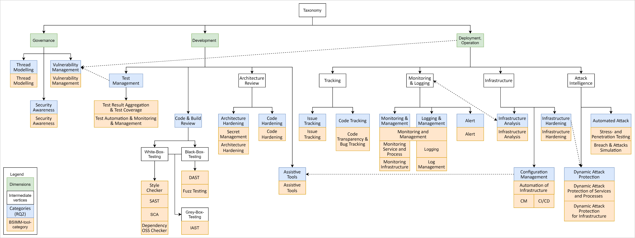
Tool classification

Slide 16
Tool classification (cont’d)
Distribution of the classification per category

Slide 17
Tool classification (cont’d)
Tool-classification-matrix
Category | Tool
Threat Modeling | IriusRisk, no name (attack graph generation), OWASP Threat Dragon, Scoria, ThreatModeler
Security Awareness | Data-driven Security Game, Secure Code Warrior, SpongeBugs, Stethoscope, WhiteHat Sentinel Application Security Platform
Vulnerability Management | HackerOne, no name (commit message analysis), no name (semantic wiki), QL, SD Elements
Code & Build Review | Actuary, Acunetix, American Fuzzy lop, Anchore, API Fuzzer, AppScan, Aqua Security, Arachni, ASIDE, bandit, Black Duck, Blueflower, Brakeman, Bundler Audit, Burp Proxy, Burp Suite, Checkmarx, Checkstyle, Cigital SecureAssist, CIMPLIFIER, Clair, Clang Static Analyzer, Clirr, Codacy, Code Climate, CodeAI, CodeNarc, CodeSonar, CodeWarrior, ConPan, Contrast Assess, Coverity, CPP Check, cpplint, Dagda, David, Dawn Scanner, Deep Drive, Detectify, DevSkim, Docker Bench, Error Prone, ESLint, ESVD,Find Securiy Bugs, Findbugs, Flawfinder, Fortify on Demand SaaS, Fortify Static Code Analyzer HPE, Fortify Webinspect, FuzzDb, Gmetrics, Grep Rough Audit, Hakiri Toolbelt, Infer, Insure++, IntelliJ, jDepend, JSHint, Jtest, Kiuwan, KLEE, Klocwork, Lapse+, Maven, Microsoft Security Code Analysis, MobSF (Mobile Security Framework), no name (SAST and dynamic execution), no name (SAST with ML), no name (toolchain IAST), NodeJsScan, NowSecure Lab Automated, OpenSCAP, OWASP Dependency Check, OWASP SafeNuGet, OWASP ZAP, Phan, PHP Security Checker, PHPMD (mess Detector), PMD, PrivacyScore, Puma Scan, PVS-Studio, Pylint, Radamsa, RapidScan, Retire.js, RIPS, RuboCop, Ruby-lint, SAGE, SCALe, ScanJS, Secfuzz, Security Linter for Infrastructure as Code scripts (SLIC), SeekerIAST, Snallygaster, Snooze, Snyk, SonarCloud, SonarLint, SonarQube, Sonatype Nexus Lifecycle, SourceClear, Splint, SpotBugs, SQL Injection ME, Sqreen, standardJS, SWAMP, Sys, Sysdig Secure, Trufflehog, Twistlock, VeraCode (CA),Veracode Software Composition Analysis, Visual Studio, VisualCodeGrepper (VCG), Wfuzz, WhiteHat Sentinel Application Security Platform, WhiteSource, XSS ME
Test Management | Bamboo, Chef InSpec, Cobertura, Codacy, Code Climate, Code Dx, coveralls, DefectDojo, DrTest, Faraday, GitLab, Istanbul, JackHammer, Jenkins, Jest, JSCover, Klaros, LogCoCo, OWASP Code Pulse, Phantom (Splunk Phantom), Rational Quality, Manager (IBM Engineering Test Management), Seccubus, Selenium, SeleniumBase, ThreadFix, WhiteHat Sentinel Application Security Platform
Architecture Hardening | Chef Vault, credstash, CyberArk Conjur, GOBLIN, HashiCorp Vault, Jsart, Keywhiz, no name (clone detection), no name (identify unsecure dataflows), Privtrans, Red October, Scoria, sneaker, Square KeyWhiz project, Trousseau, Venafi Trust Protection Platform
Code Hardening | PHP Aspis
Assistive Tools | ActiveState Platform, fffuu
Monitoring & Logging | Alert Logic, AlienValut OSSIM, AppDynamics, AppScan, Artifactory (JFROG), AuthMatrix, Cacti, CloudMonix, CloudPassage Halo, CloudWatch, Dagda, DataDog, digital.ai, Dome9 SecOps, Dynatrace, Elasticsearch, Falco, FilebBeat, Ganglia, God, Grafana, Graphite, GrayLog, Icinga, Infocyte HUNT, Kibana, LogRhythm, Logstash, Logz.io, Monit, MUSA Security Assurance Platform (MSAP), Nagios, New Relic, Nexpose (Rapid7), OSSEC, PagerDuty, Phantom (Splunk Phantom), Pingdom, PortVis, Prometheus, Qualys (cloud platform), Redlock (Evident.io), ReGrade, Rsyslog, runit, Sensu, Snort, Splunk (enterprise), SumoLogic, Supervisor, Suricata, Syslog-NG, systemd, Threat Stack, VictorOps, Zabbix
Automated Attack | BDD-Security, Chaos Monkey, Dagda, FlashOver, Gauntlt, Infection Monkey, Metasploit, Mittn, Mozilla Minion, ntpDoS, OWTF, Penetration testing toolkit, Pwnloris, Slowloris, Snuck, SQLMap, Thc-sll-DoS, Wreckuests
Dynamic Attack Protection | CANDID, Contrast Protect, Contrast Security, Fortfy Application Defender, Illumio, Immunio, NeuVector, OpenRASP, Prevoty, Signal Science, tCell, Waratek
Code Tracking | Atlassian Crucible, Gerrit, loggly, PaperTrail, Phabricator
Issue Tracking | Bugzilla, JIRA, Redmine
Alert | Alerta, AppDynamics, DataDog, Dynatrace, ElastAlert, HipChat, Logz.io, Nagios, New Relic, PagerDuty, Phantom (Splunk Phantom), Pingdom, Prometheus, Slack,Splunk (enterprise), VictorOps
Infrastructure Hardening | GPG
Infrastructure Analysis | Amazon AWS Inspector, Chefspec, CIS Benchmarks, CVEChecker, Dagda, Dome9 Arc, fffuu, GRaViTY, Hping, Jmeter, LMD (linux malware detection), Lynis Security Auditing, masscan, Nessus, NMAP, OpenVAS, SECUBAT, Serverspec, SSLyze, Stethoscope, Test Kitchen,Tripwire, VirusTotal, Whatweb, Wireshark
Configuration Management | Ansible, Charles Proxy, Chef, Cloudbees, digital.ai, Istio, LGTM, NeuVector, Palerra LORIC, Puppet, Rational Team Concert (IBM Engineering Workflow Management), SaltStack, StackStorm, topoS

Slide 18
Tool-support of BSIMM10-activities
BSIMM translation process
Activity | Summary | A | Translation | Example
SM1.1 | Make the security plan public to all relevant entities | N | The process and decision to issue a security plan is a decision-making activity | -
T1.1 | Improve awareness regarding security and privacy concepts of individuals | Y | Here, we look at tools that facilitate the security and privacy awareness of an individual. Tools like DdSG can improve security perception by training, e.g., attack patterns through playing a tower-defense game. This approach can be made through any kind of e-learning tool. We want to note that the respective organizations can execute this approach without additional manual effort. In contrast, the learning process for individuals is not automatable | DdSG
T1.7 | Provide customized teaching of security and privacy concepts | Y | Any kind of tool that can give customized teaching of security and privacy concepts belong to this activity. In particular, all SAST, IAST, and DAST tools are matched to this activity. For example, the SAST tool Findbugs can give developers real-time feedback on common security vulnerabilities, depending on their respective code. It is noteworthy that T1.7 is directly connected to T1.1 because tools can be individually adjusted to the participant’s experience. | Findbugs
SE1.1 | Implement monitoring for input data | Y | For this activity, we look into two major approaches: logging and monitoring. Tools capable of monitoring either infrastructure or software, such as Grafana and infrastructure logging tools like SumoLogic, match this activity. Furthermore, we also assign hybrid-tools that require monitoring to work correctly, such as RASP tools. | Grafana, SumoLogic
CMVM3.3 | Mimic attacks on software security | Y | For this matter, we identified several tools that can automatically mimic an attack, such as DOS-attacks or unplug randomly severs like Chaos Monkey. | Chaos Monkey

Slide 19
Tool-support of BSIMM10-activities (cont’d)
Distribution per BSIMM-dimension, separated between artifact types

Slide 20
Tool-support of BSIMM10-activities (cont’d)
Distribution per BSIMM-practice without non-tool-supported activities

Slide 21
Tool-support of BSIMM10-activities (cont’d)
Examples
Tool |  | Matched BSIMM-activities
Aqua Security | https://www.aquasec.com/ | SFD3.2, SR2.4, SR3.1, CR1.2, CR1.4, CR1.5, CR2.7, CR3.4
Brakeman | https://brakemanscanner.org/ | T1.7, SFD3.2, SR3.3, CR1.2, CR1.4, CR1.5, CR2.7, CR3.4, CR3.5
Chef Vault | https://github.com/chef/chef-vault | SE3.2
ConPan | - | SFD3.2, SR2.4, SR3.1, CR1.2, CR1.4, CR1.5, CR2.7, CR3.4
Gauntlt | http://gauntlt.org/ | AM3.2, ST2.1
NMAP | https://nmap.org/ | SE1.2
OWASP ZAP | https://owasp.org/www-project-zap/ | ST1.1, ST2.1, ST2.6, PT1.3
Snort | https://www.snort.org/ | SE1.1, SE1.2, SE3.3
Wireshark | https://www.wireshark.org/ | SE1.2

Slide 22
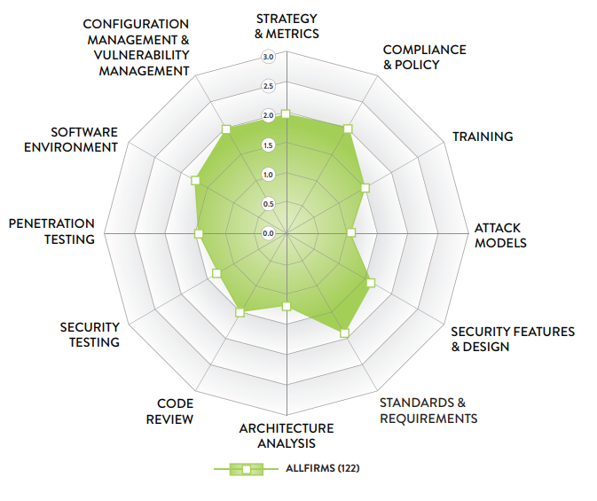
Tool-support of BSIMM10-activities (cont’d)
Average highest watermark by BSIMM-firms
Highest watermark by all identified tools
Highest watermark by S. Migues, J. Steven, and M. Ware, “BSIMM 10,” 2019. [Online]. Available: www.bsimm.com.

Slide 23
Outline
  Motivation and background
  Research goal and methodology
    Methodology
    Research questions
    Search strategy
  Results
    Key drivers for security automation tools
    Tool classification
    Mapping of tools with security activities
  Summary
    Conclusion
    Limitations
  Bibliography

Slide 24
Conclusion
Key points
Scalability and efficiency key driver for implementing security automation
Majority of tools concerns with code and build review
Governance related activities are neglected by identified tools
Challenges of tools
Emphasis on culture
Management of tools
Future research
Tool-study
In-depth analysis of cross-tool-integration
Tools within the IT governance area of different sized firms
Change of perspective on tools

Slide 25
Limitations
Non-peer-reviewed artifacts
Google Search Engine results might be biased
Dependency between artifacts
Sample size
No practical implementation of all tools

Slide 26
Limitations (cont’d)
Security and privacy automation is not a silver bullet
Utilization of security tools assume an established security-aware culture and knowledge
Wide range of skills required
Integration of new tools
  Conflict with legacy systems
  Conflict with an established mindset [7]
Faded boundaries between the security team and developers [8]
Additional cost
  Need for additional education and improved culture
  Acquiring new tools and technologies
Cross-team cooperation necessary [1]
Isolated tools to solve specific problems [11]
→ We also look into centralized solutions
Security tools
Knowledge: security training
Culture: caring about security
Continuously tracking security measurements
Based on Tomas, N., Li, J., & Huang, H. (2019). An Empirical Study on Culture, Automation, Measurement, and Sharing of DevSecOps. 2019 International Conference on Cyber Security and Protection of Digital Services (Cyber Security), 1–8.

Slide 27
Outline
  Motivation and background
  Research goal and methodology
    Methodology
    Research questions
    Search strategy
  Results
    Key drivers for security automation tools
    Tool classification
    Mapping of tools with security activities
  Summary
    Conclusion
    Limitations
  Bibliography

Slide 28
Bibliography
[1] Myrbakken, H., & Colomo-Palacios, R. (2017). DevSecOps: A Multivocal Literature Review. https://doi.org/10.1007/978-3-319-67383-7_2
[2] Phil, G. D. (2017). Compliance at Velocity within a DevOps Environment. In Muhammad Zaid Abrahams. University of Johannesburg.
[3] Ahmed, A. M. (2019). DevSecOps : Enabling Security by Design in Rapid Software Development.
[4] Uludag, Ö., Kleehaus, M., Caprano, C., & Matthes, F. (2018). Identifying and structuring challenges in large-scale agile development based on a structured literature review. Proceedings - 2018 IEEE 22nd International Enterprise Distributed Object Computing Conference, EDOC 2018, 191–197. https://doi.org/10.1109/EDOC.2018.00032
[5] Filkins, B., Bird, J., & Kim, F. (2014). Survey on Application Security Programs and Practices. SANS Technology Institute.
[6] A. Koskinen, “DEVSECOPS: BUILDING SECURITY INTO THE CORE OF DEVOPS,” University of Jyväskylä, 2019.
[7] Meera Rao. (2018). The challenges of shifting to DevSecOps. https://www.itproportal.com/features/the-challenges-of-shifting-to-devsecops/
[8] Isaac Eldridge. (2018). SecDevOps: Injecting Security Into DevOps Processes. Retrieved June 6. 2020, from https://blog.newrelic.com/technology/what-is-secdevops/
[9] Center, N. J. S. (2010). Error cost escalation through the project life cycle. Source of Acquisition NASA Johnson Space Center.
[10] Scandariato, R., Horkhoff, J., & Feldt, R. (2018). Generative Secure Design, Defined. Proceedings of the 40th International Conference on Software Engineering: New Ideas and Emerging Results, 1–4. https://doi.org/10.1145/3183399.3183400
[11] Islam, C., Babar, M. A., & Nepal, S. (2019). A Multi-Vocal Review of Security Orchestration. ACM Comput. Surv., 52(2). https://doi.org/10.1145/3305268
[12] Tomas, N., Li, J., & Huang, H. (2019). An Empirical Study on Culture, Automation, Measurement, and Sharing of DevSecOps. 2019 International Conference on Cyber Security and Protection of Digital Services (Cyber Security), 1–8. https://doi.org/10.1109/CyberSecPODS.2019.8884935
[13] Vila, E., Novakova, G., & Todorova, D. (2017). Automation Testing Framework for Web Applications with Selenium WebDriver: Opportunities and Threats. Proceedings of the International Conference on Advances in Image Processing, 144–150. https://doi.org/10.1145/3133264.3133300
[14] Garousi, V., Felderer, M., & Mäntylä, M. V. (2017). Guidelines for including grey literature and conducting multivocal literature reviews in software engineering. Information and Software Technology, 106, 101–121.
[15] Hack2Secure. BSIMM Software Security Framework A Quick Walkthrough: Retrieved June 13. 2020, from https://www.hack2secure.com/blogs/BSIMM-Software-Security-Framework-A-Quick-Walkthrough

Slide 29
John Nguyen
17132
matthes@in.tum.de

Slide 30
Backup Slides

Slide 31
Schedule
Thesis Kickoff
Submission
Thesis completion
15 Jun
29 Oct
15 Nov
2020
Jun
Jul
Aug
Sep
Oct
Nov
2020
Today
Preparation Phase
5 days
Research Phase
62 days
Writing Phase
50 days
Correction Phase
12 days
Buffer
13 days
28 Oct - 15 Nov

Slide 32
Motivation and background
Numbers of record lost in Mio.
Name of the company
Challenge: More and more data is being stored and processed → Volume of stolen data increases
Issues:
Violation of security principles
  Least privilege
  Defense in depth
  Minimum exposure
Lack of security training
  Security awareness [8]
Old technologies [9]
Conflict of interests between stakeholders
  Focus on functional requirements
  Developers ↔ Architects ↔ Management
Note: Worldwide; April 2020; based on number of records lost
Further information regarding this statistic can be found on page 8.
Source(s): Information is Beautiful; Various sources (VizSweet); Thomson Reuters; ID 290525

Slide 33
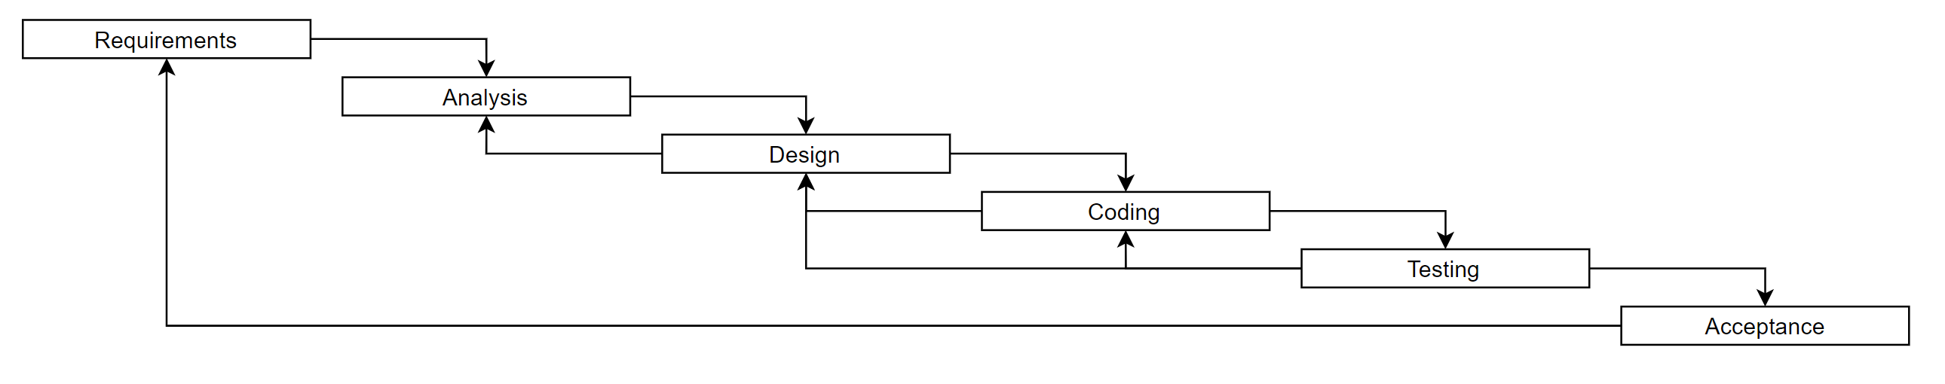
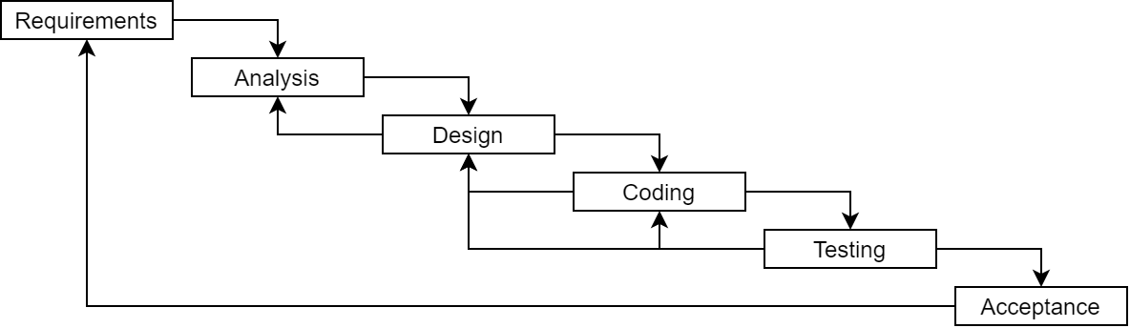
Not so different after all
Waterfall
Agile
DevOps
DevOps
At Scale
Time

Slide 34
Questions to determine the need for an MLR
# | Question | Justification
1 | Is the subject “complex” and not solvable by considering only the formal literature? | Yes. The formal literature cannot represent all relevant security and privacy tools due to the rapid change and complexity of security and privacy concerns.
2 | Is there a lack of volume or quality of evidence, or a lack of consensus of outcome measurement in the formal literature? | Yes. The industrial setting is required to give an overview of all relevant tools.
3 | Is the contextual information important to the subject under study? | Yes. We focus on security and privacy tools within a particular context (DevOps and agile).
4 | Is it the goal to validate or corroborate scientific outcomes with practical experiences? | Yes. Focus on practical views on tools regarding privacy and security concerns.
5 | Is it the goal to challenge assumptions or falsify results from practice using academic research or vice versa? | Yes. There is a research gap in-between tool interaction and how non-automatable activities can be considered in the automation process.
6 | Would a synthesis of insights and evidence from the industrial and academic community be useful to one or even both communities? | Yes. Finding gaps within the toolchain can support the development of more centralized tools and identify potential weaknesses. This also supports the overall flexibility of the software development process.
7 | Is there a large volume of practitioner sources indicating high practitioner interest in a topic? | Yes. Security and privacy automation tools are getting more and more relevant due to digitalization.
Garousi, V., Felderer, M., & Mäntylä, M. V. (2017). Guidelines for including grey literature and conducting multivocal literature reviews in software engineering. Information and Software Technology, 106, 101–121.

Slide 35
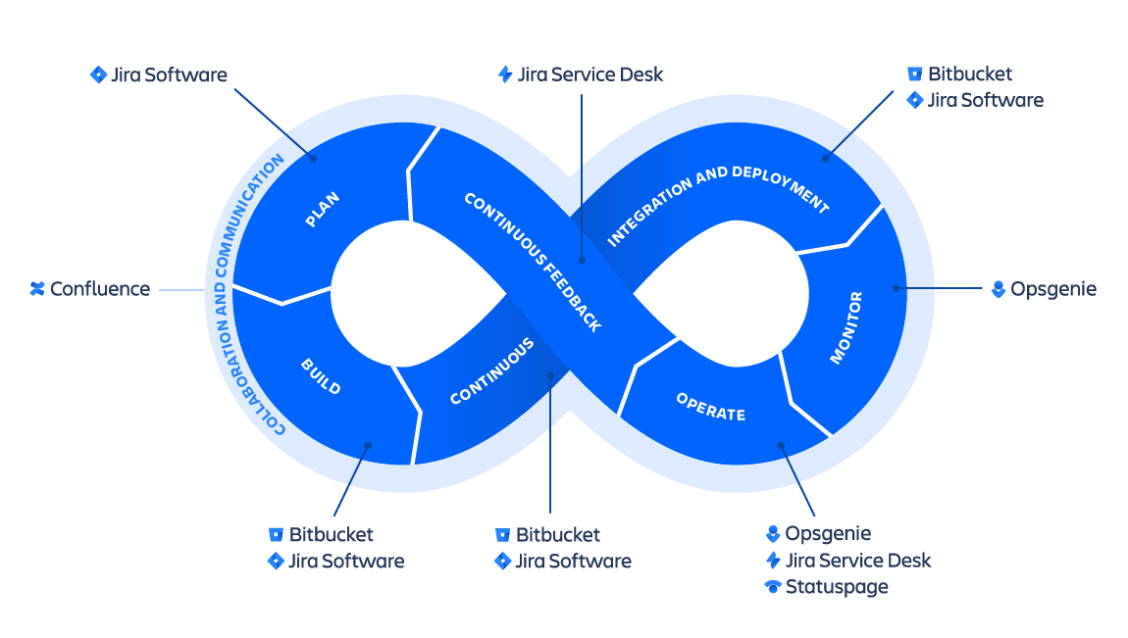
DevOps
https://wac-cdn.atlassian.com/dam/jcr:cd64c6de-34a3-436f-95e0-f8e600143dac/SWTMNG-263%20DevOps%20infinity%20wheel_CLOUD-PRODUCTS@2x.png?cdnVersion=1060 (Date: 06.06.2020)

Slide 36
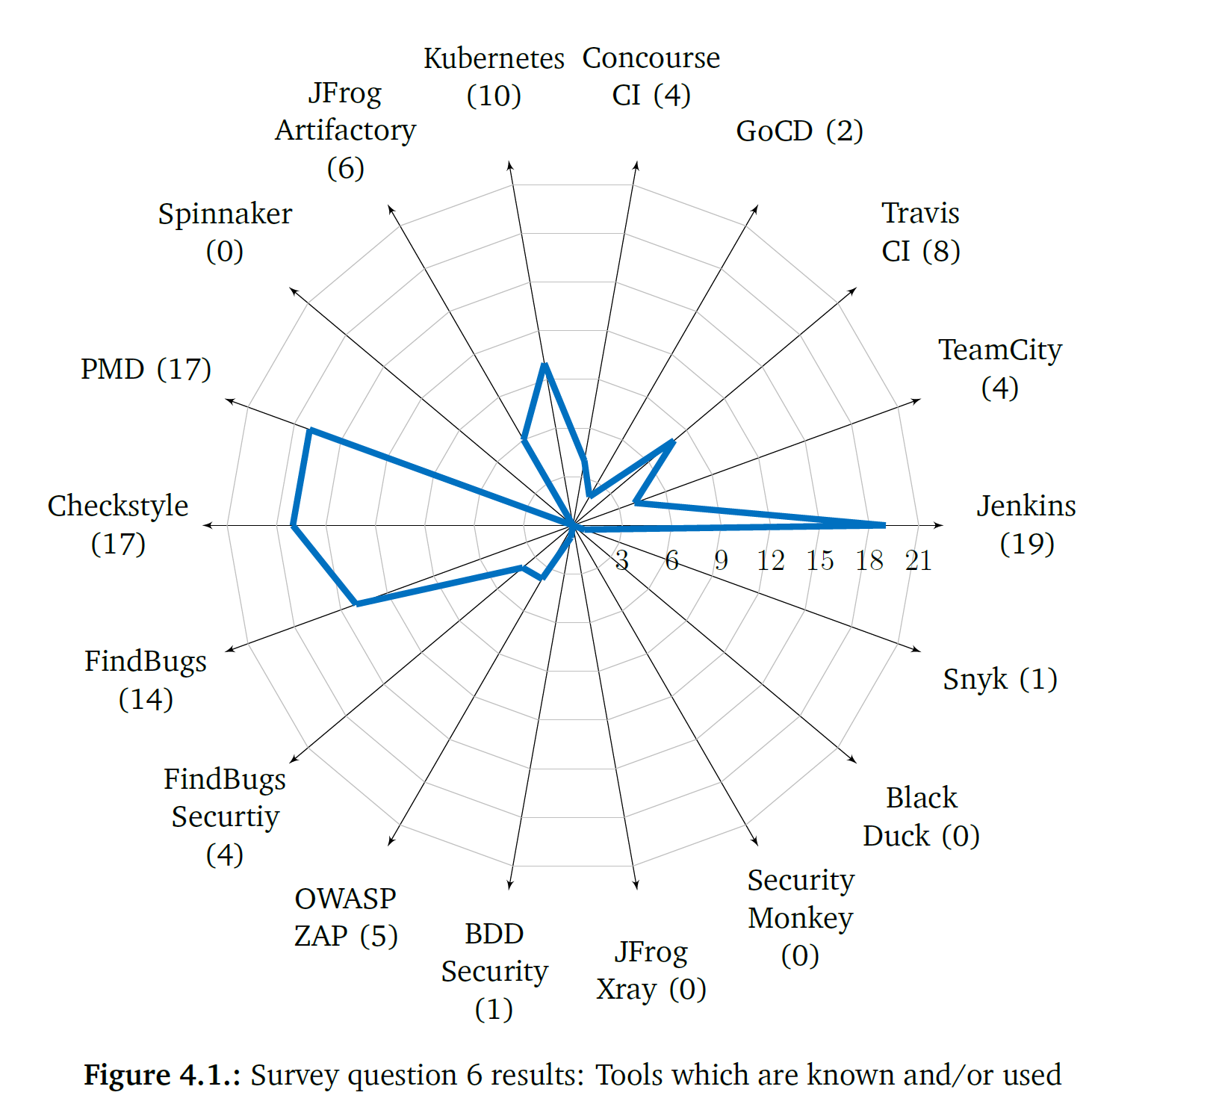
Knowledge of developers (2018)
100 employees of a selected industrial company
“Which tools do you know and/or use?
Response options:
(DevOps tools) Jenkins; Kubernetes; TeamCity; Spinnaker; Travis; GoCD; Concourse CI; JFrog Artifactory;
(static analysis tools) PMD; Checkstyle; FindBugs; FindBugs Security;
(security tools) OWASP ZAP; BDD Security; JFrog Xray; Security Monkey; Black Duck; Snyk” [1]
Paule, C. (2018). Securing DevOps: detection of vulnerabilities in CD pipelines Figure 4 p. 45 [1]

Slide 37
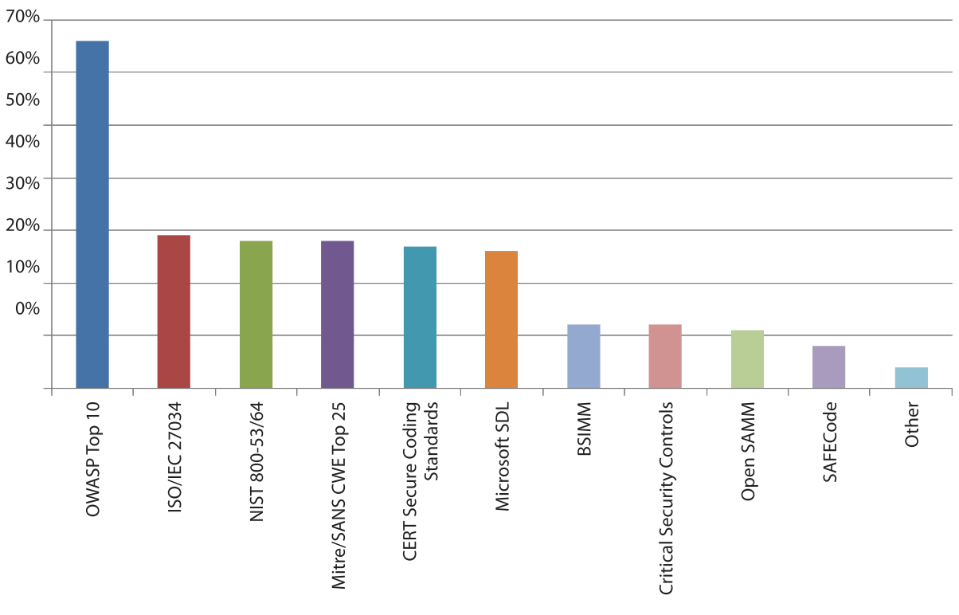
Security standards and model (2016)
“What application security standards or models do you follow? Select all that apply.” [5]
435 respondents
OWASP Top 10 leading standard
Shackleford, D. (2016). A DevSecOps Playbook. SANS Institute InfoSec Reading Room. A DevSecOps Playbook Figure 2 p. 11 [5]

Slide 38
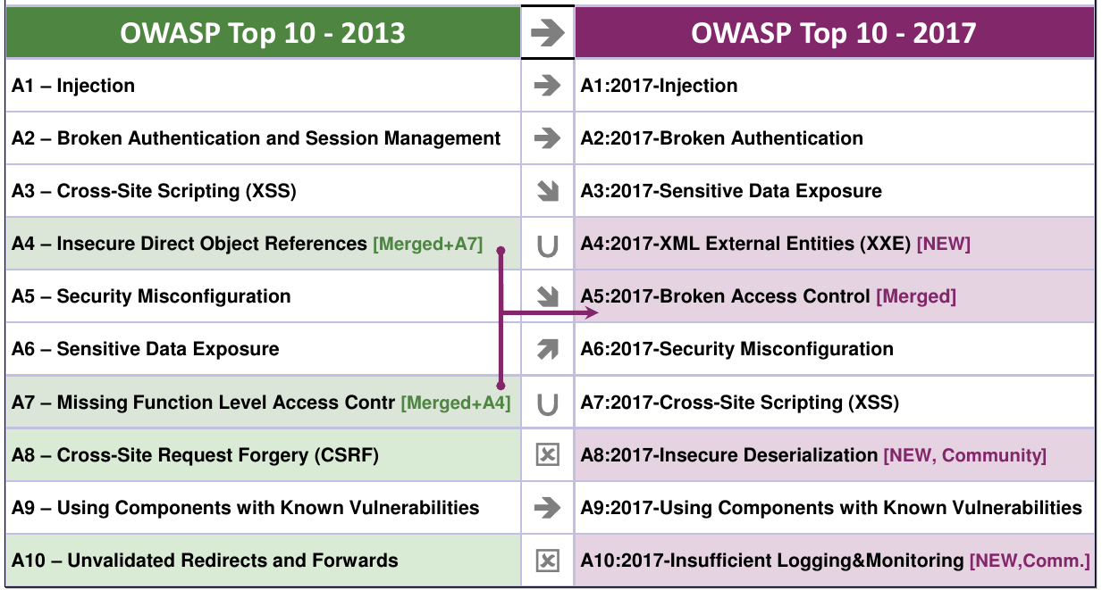
OWASP
International non-profit organization
Focus on web application security
Goal: Improve web application security
OWASP Top 10: represents top 10 risks (critical) [3]
https://www.heise.de/developer/imgs/06/2/3/6/0/4/7/9/2013-2017-50ed3603697420a0.png (Date: 04.06.2020]

Slide 39
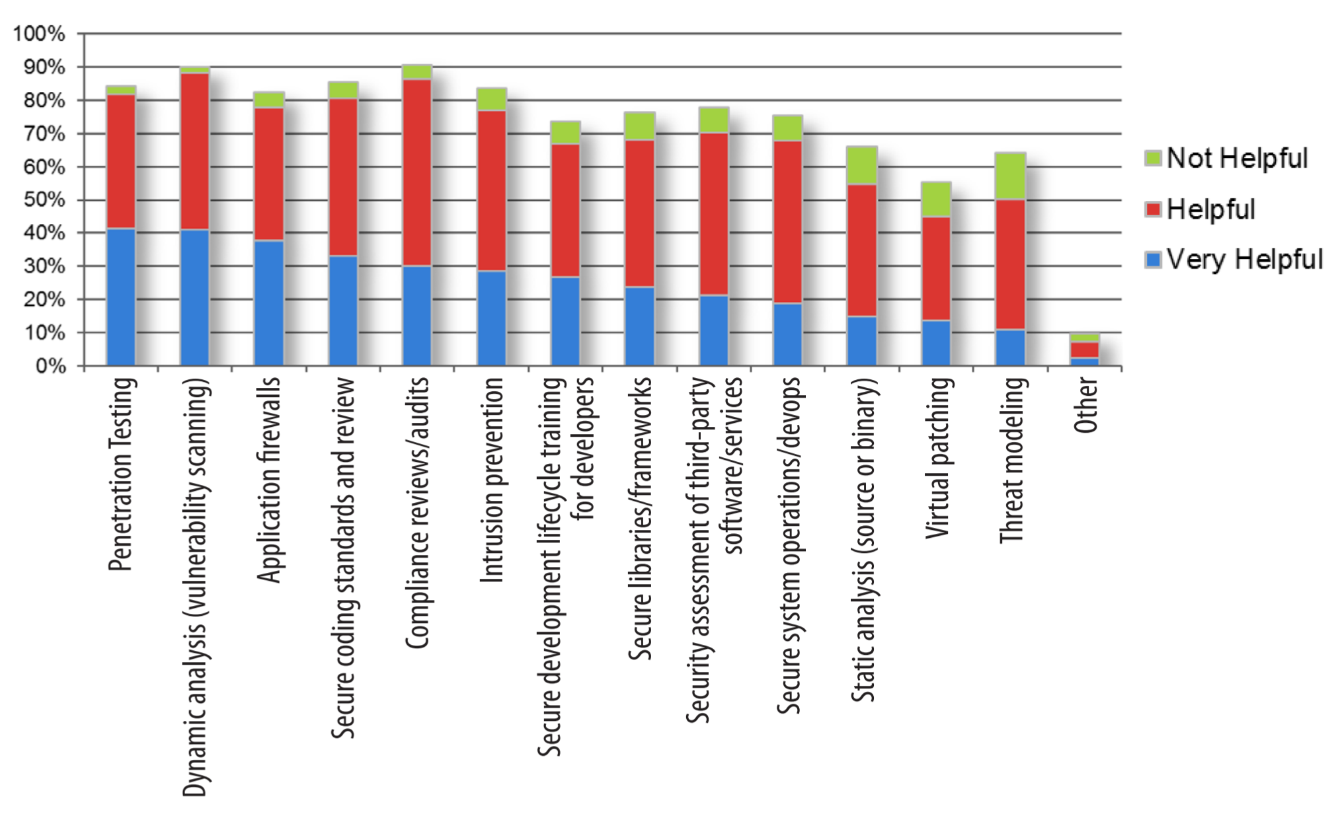
Security practices with rating
Filkins, B., Bird, J., & Kim, F. (2014). Survey on Application Security Programs and Practices. SANS Technology Institute. Figure 11. Effective Appsec Security Practices

Slide 40
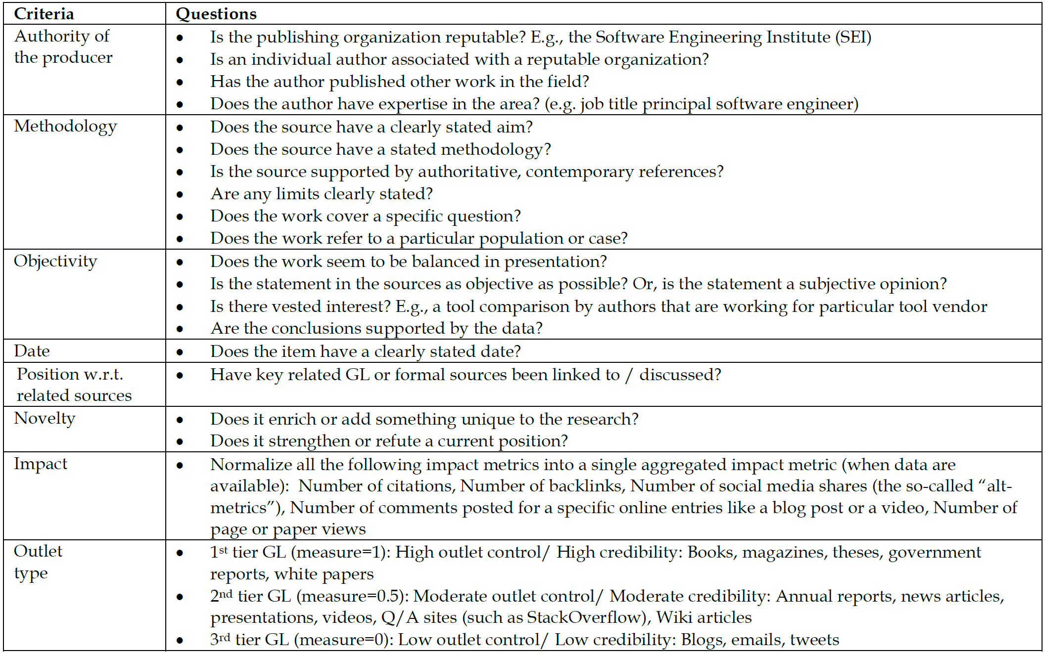
Quality assessment in MLRs
Garousi, V., Felderer, M., & Mäntylä, M. V. (2017). Guidelines for including grey literature and conducting multivocal literature reviews in software engineering. Information and Software Technology, 106, 101–121. Table 7-Quality assessment checklist of grey literature for software engineering

Slide 41
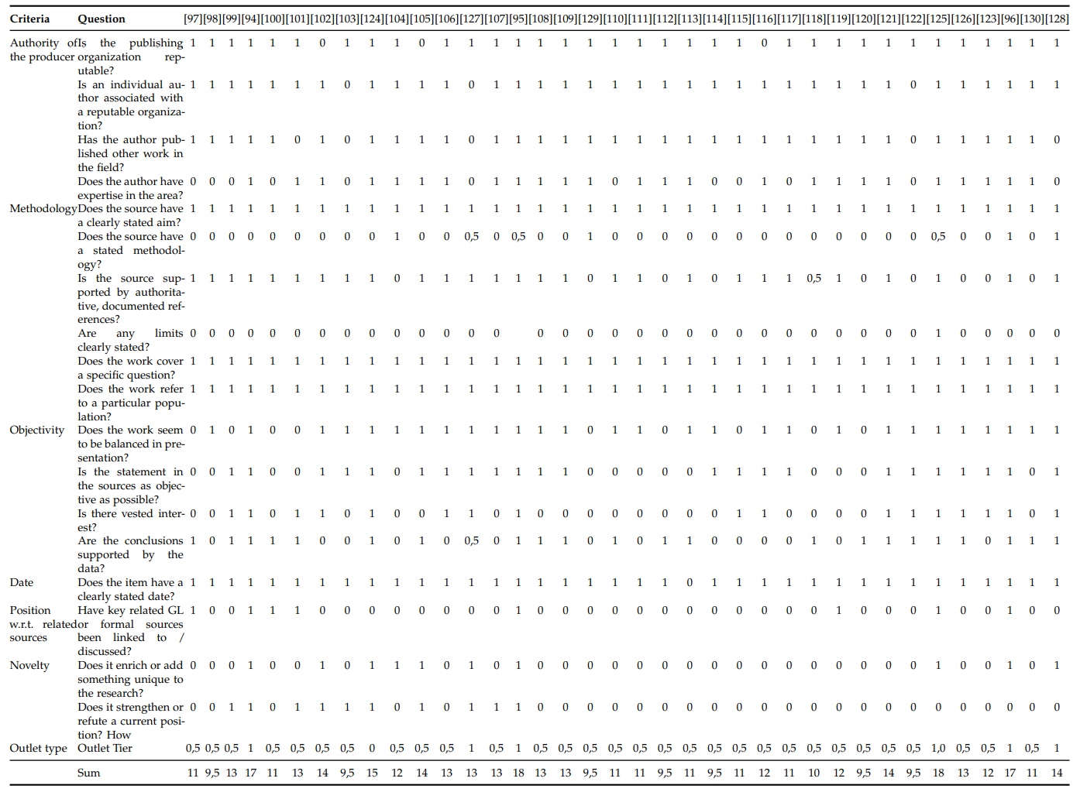
Quality assessment in MLRs (cont’d)

Slide 42
Search strategy
Concept distribution between artifacts
Academic literature
Grey literature

Slide 43
BSIMM10
GOVERNANCE
INTELLIGENCE
STRATEGY & METRICS (SM)
• SM1.1 Publish process and evolve as necessary.
• SM1.2 Create evangelism role and perform internal marketing.
• SM1.3 Educate executives.
• SM1.4 Identify gate locations, gather necessary artifacts.
• SM2.1 Publish data about software security internally.
• SM2.2 Enforce gates with measurements and track exceptions.
• SM2.3 Create or grow a satellite.
• SM2.6 Require security sign-off.
• SM3.1 Use an internal tracking application with portfolio view.
• SM3.2 Run an external marketing program.
• SM3.3 Identify metrics and use them to drive budgets.
• SM3.4 Integrate software-defined lifecycle governance.
COMPLIANCE & POLICY (CP)
• CP1.1 Unify regulatory pressures.
• CP1.2 Identify PII obligations.
• CP1.3 Create policy.
• CP2.1 Identify PII inventory.
• CP2.2 Require security sign-off for compliance-related risk.
• CP2.3 Implement and track controls for compliance.
• CP2.4 Include software security SLAs in all vendor contracts.
• CP2.5 Ensure executive awareness of compliance and privacy obligations.
• CP3.1 Create a regulator compliance story.
• CP3.2 Impose policy on vendors.
• CP3.3 Drive feedback from software lifecycle data back to policy.
TRAINING (T)
• T1.1 Conduct awareness training.
• T1.5 Deliver role-specific advanced curriculum.
• T1.7 Deliver on-demand individual training
• T2.5 Enhance satellite through training and events.
• T2.6 Include security resources in onboarding.
• T2.8 Create and use material specific to company history.
• T3.1 Reward progression through curriculum.
• T3.2 Provide training for vendors or outsourced workers.
• T3.3 Host software security events.
• T3.4 Require an annual refresher.
• T3.5 Establish SSG office hours.
• T3.6 Identify new satellite members through training
ATTACK MODELS (AM)
• AM1.2 Create a data classification scheme and inventory.
• AM1.3 Identify potential attackers.
• AM1.5 Gather and use attack intelligence.
• AM2.1 Build attack patterns and abuse cases tied to potential attackers.
• AM2.2 Create technology-specific attack patterns.
• AM2.5 Build and maintain a top N possible attacks list.
• AM2.6 Collect and publish attack stories.
• AM2.7 Build an internal forum to discuss attacks.
• AM3.1 Have a science team that develops new attack methods.
• AM3.2 Create and use automation to mimic attackers.
• AM3.3 Monitor automated asset creation.
SECURITY FEATURES & DESIGN (SFD)
• SFD1.1 Build and publish security features.
• SFD1.2 Engage the SSG with architecture teams.
• SFD2.1 Leverage secure-by-design middleware frameworks and common libraries.
• SFD2.2 Create an SSG capability to solve difficult design problems.
• SFD3.1 Form a review board or central committee to approve and maintain secure design patterns.
• SFD3.2 Require use of approved security features and frameworks.
• SFD3.3 Find and publish mature design patterns from the organization.
STANDARDS & REQUIREMENTS (SR)
• SR1.1 Create security standards.
• SR1.2 Create a security portal.
• SR1.3 Translate compliance constraints to requirements.
• SR2.2 Create a standards review board.
• SR2.4 Identify open source.
• SR2.5 Create SLA boilerplate.
• SR3.1 Control open source risk.
• SR3.2 Communicate standards to vendors.
• SR3.3 Use secure coding standards.
• SR3.4 Create standards for technology stacks.

Slide 44
BSIMM10 (cont’d)
SSDL TOUCHPOINTS
DEPLOYMENT
ARCHITECTURE ANALYSIS (AA)
• AA1.1 Perform security feature review.
• AA1.2 Perform design review for high-risk applications.
• AA1.3 Have SSG lead design review efforts.
• AA1.4 Use a risk questionnaire to rank applications.
• AA2.1 Define and use AA process.
• AA2.2 Standardize architectural descriptions.
• AA3.1 Have engineering teams lead AA process.
• AA3.2 Drive analysis results into standard architecture patterns.
• AA3.3 Make the SSG availab
CODE REVIEW (CR)
• CR1.2 Have the SSG perform ad hoc review.
• CR1.4 Use automated tools along with manual review.
• CR1.5 Make code review mandatory for all projects.
• CR1.6 Use centralized reporting to close the knowledge loop and drive training.
• CR2.5 Assign tool mentors.
• CR2.6 Use automated tools with tailored rules.
• CR2.7 Use a top N bugs list (real data preferred).
• CR3.2 Build a capability to combine assessment results.
• CR3.3 Eradicate specific bugs from the entire codebase.
• CR3.4 Automate malicious code detection.
• CR3.5 Enforce coding standards. ST1.1 Ensure QA supports edge/boundary value condition testing.
SECURITY TESTING (ST)
• ST1.3 Drive tests with security requirements and security features.
• ST2.1 Integrate black-box security tools into the QA process.
• ST2.4 Share security results with QA.
• ST2.5 Include security tests in QA automation.
• ST2.6 Perform fuzz testing customized to application APIs.
• ST3.3 Drive tests with risk analysis results.
• ST3.4 Leverage coverage analysis.
• ST3.5 Begin to build and apply adversarial security tests (abuse cases).
PENETRATION TESTING (PT)
• PT1.1 Use external penetration testers to find problems.
• PT1.2 Feed results to the defect management and mitigation system.
• PT1.3 Use penetration testing tools internally.
• PT2.2 Penetration testers use all available information.
• PT2.3 Schedule periodic penetration tests for application coverage.
• PT3.1 Use external penetration testers to perform deep-dive analysis.
• PT3.2 Have the SSG customize penetration testing tools and scripts.
SOFTWARE ENVIRONMENT (SE)
• SE1.1 Use application input monitoring.
• SE1.2 Ensure host and network security basics are in place.
• SE2.2 Publish installation guides.
• SE2.4 Use code signing.
• SE3.2 Use code protection.
• SE3.3 Use application behavior monitoring and diagnostics.
• SE3.4 Use application containers.
• SE3.5 Use orchestration for containers and virtualized environments.
• SE3.6 Enhance application inventory with operations bill of materials.
• SE3.7 Ensure cloud security basics.
CONFIGURATION MANAGEMENT & VULNERABILITY MANAGEMENT (CMVM)
• CMVM1.1 Create or interface with incident response.
• CMVM1.2 Identify software defects found in operations monitoring and feed them back to development.
• CMVM2.1 Have emergency codebase response.
• CMVM2.2 Track software bugs found in operations through the fix process.
• CMVM2.3 Develop an operations inventory of applications.
• CMVM3.1 Fix all occurrences of software bugs found in operations.
• CMVM3.2 Enhance the SSDL to prevent software bugs found in operations.
• CMVM3.3 Simulate software crises.
• CMVM3.4 Operate a bug bounty program.
• CMVM3.5 Automate verification of operational infrastructure security [10]

Slide 45
Demographic distribution of grey and academic literature

Slide 46
Tool-support of BSIMM10-activities
Distribution per BSIMM-dimension

Slide 47
Distribution between free and commercial tools

Slide 48
Tool-support of BSIMM10-activities
Distribution per BSIMM-practice

Slide 49
Cross-tool-integration
Developers often use several tools to improve the estimation and validity of the analysis [6, Sec. Secure code scanning tools]
One tool alone is often insufficient for an in-depth analysis [7]
Platform tools are facilitated to combine different results of tools
  CloudPassage Halo (https://www.cloudpassage.com/)
  digital.ai (https://digital.ai/)
  GitLab (https://about.gitlab.com/)
  Splunk Phantom (https://www.splunk.com/)

Slide 50
Bibliography
[1] Paule, C. (2018). Securing DevOps: detection of vulnerabilities in CD pipelines [University of Stuttgart]. http://elib.uni-stuttgart.de/handle/11682/10046
[2] Myrbakken, H., & Colomo-Palacios, R. (2017). DevSecOps: A Multivocal Literature Review. https://doi.org/10.1007/978-3-319-67383-7_2
[3] What is OWASP? What Are The OWASP Top 10?. Retrieved June 6. 2020, from https://www.cloudflare.com/learning/security/threats/owasp-top-10/
[5] Shackleford, D. (2016). A DevSecOps Playbook. SANS Institute InfoSec Reading Room. A DevSecOps Playbook. https://www.sans.org/reading-room/whitepapers/analyst/guarding-gateway-challenges-email-security-36597
[6] T. Hsu, Hands-On Security in DevOps: Ensure Continuous Security, Deployment, and Delivery with DevSecOps. Packt Publishing, 2018.
[7] T. D. Oyetoyan, B. Milosheska, M. Grini, and D. Soares Cruzes, “Myths and Facts About Static Application Security Testing Tools: An Action Research at Telenor Digital,” in Agile Processes in Software Engineering and Extreme Programming, 2018, pp. 86–103.
[8] Dr. Alexander Pretschner. (2020). Security Engineering. Security Principles. Retrieved June 6. 2020, from https://www.moodle.tum.de/pluginfile.php/2203779/mod_resource/content/1/Security_Engineering_110_Security_Principles.pdf
[9] Samuel Gibbs. (2016). Security experts: 'No one should have faith in Yahoo at this point’. Retrieved June 6, 2020, from https://www.theguardian.com/technology/2016/dec/15/security-experts-yahoo-hack
[10] S. Migues, J. Steven, and M. Ware, “BSIMM 10,” 2019. [Online]. Available: www.bsimm.com.

